Slide 1
Project Mini Updates
Brittany Howe & Anna Miller
T1:NBA Stats

Slide 2
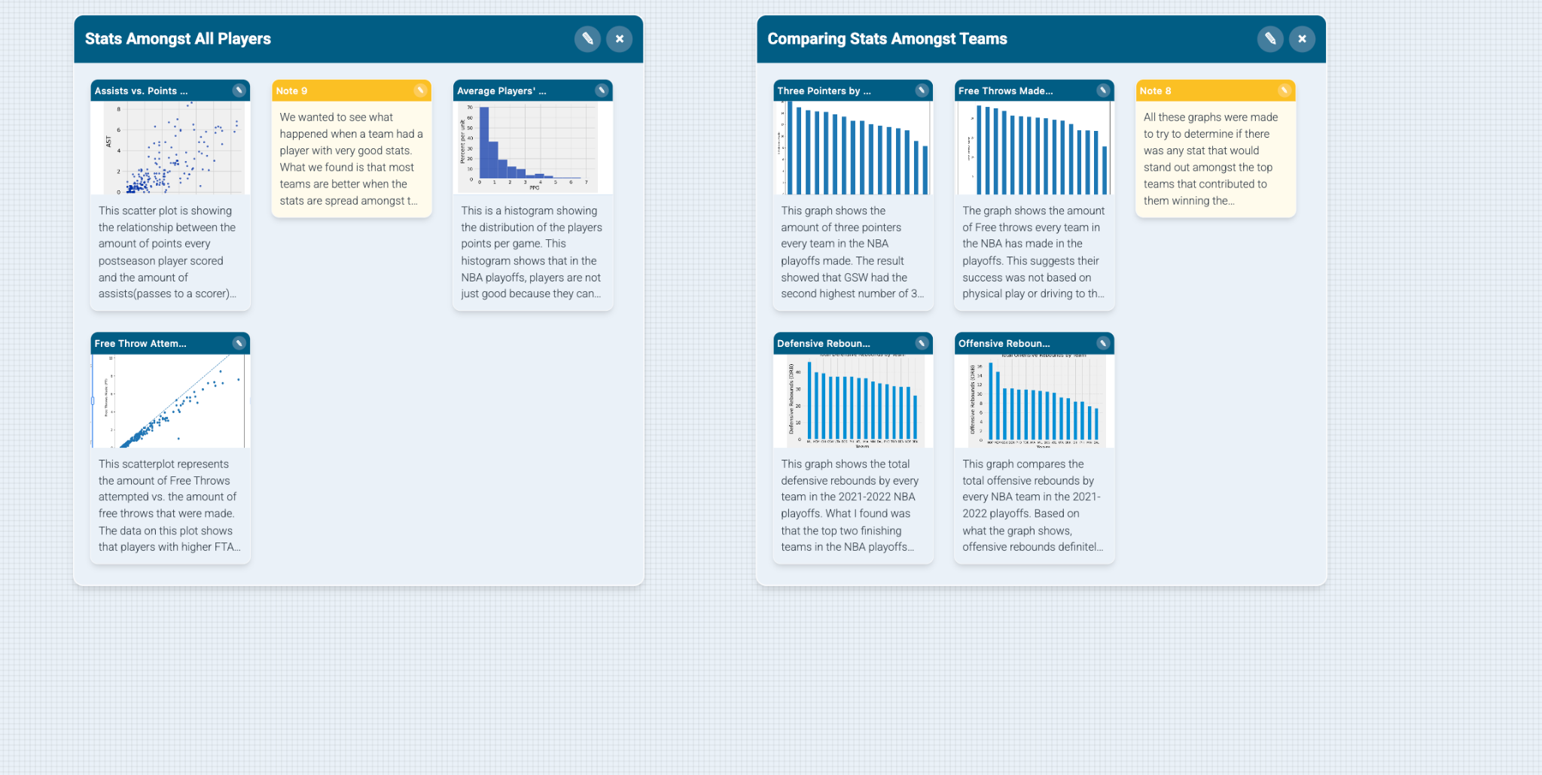
Week 5 Storyboard Brittany&Anna

Slide 3
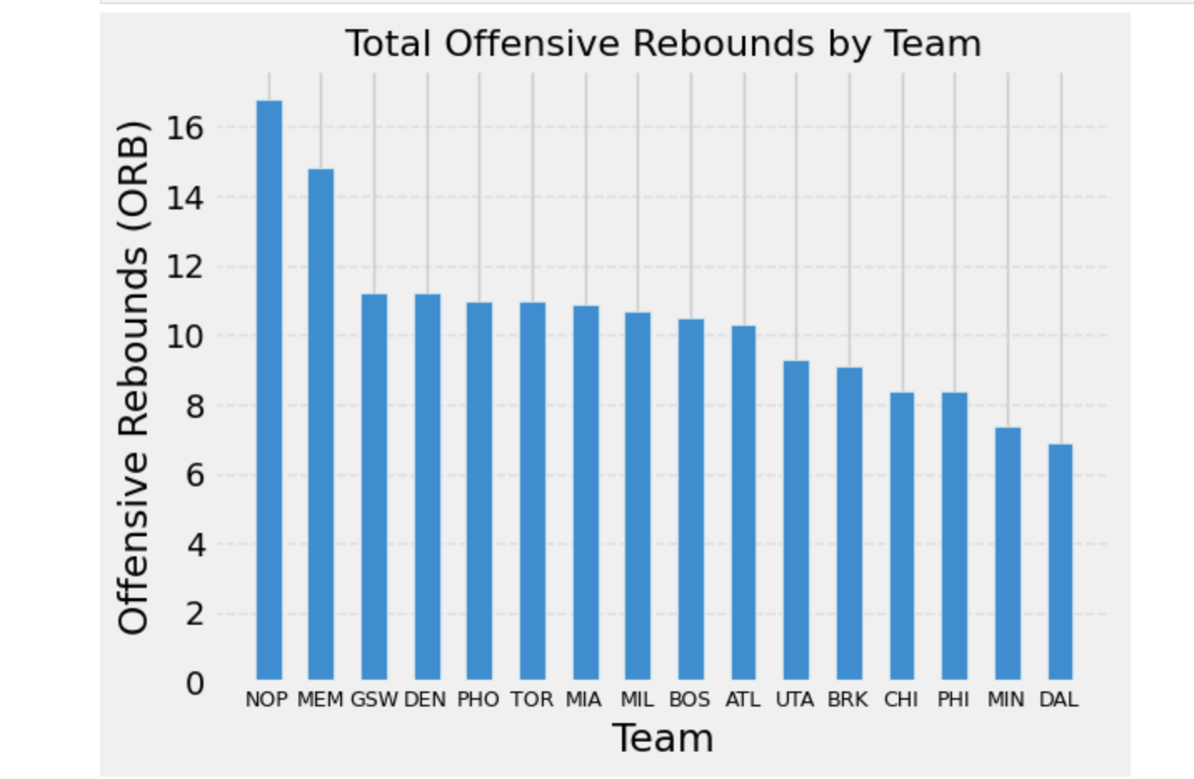
Mini Update 4-Data Insight Brittany
I made this graph to compare the total offensive rebounds by every NBA team in the 2021-2022 playoffs. I wanted to see if the offensive rebounds affected the whole performance of the team. Because GSW won the playoffs, it makes sense that they were third in this stat. What is interesting though is that the second place team, BOS, was 9th in this stat and they were the runner up in the playoffs. This tells me that offensive rebounds definitely help teams, but it is not the sole factor contributing to their wins. A team does not have to be that great at offensive rebounding, but if they are, it will definitely improve their chances at winning.
I wonder if this is the case with defensive rebounds as well?

Slide 4
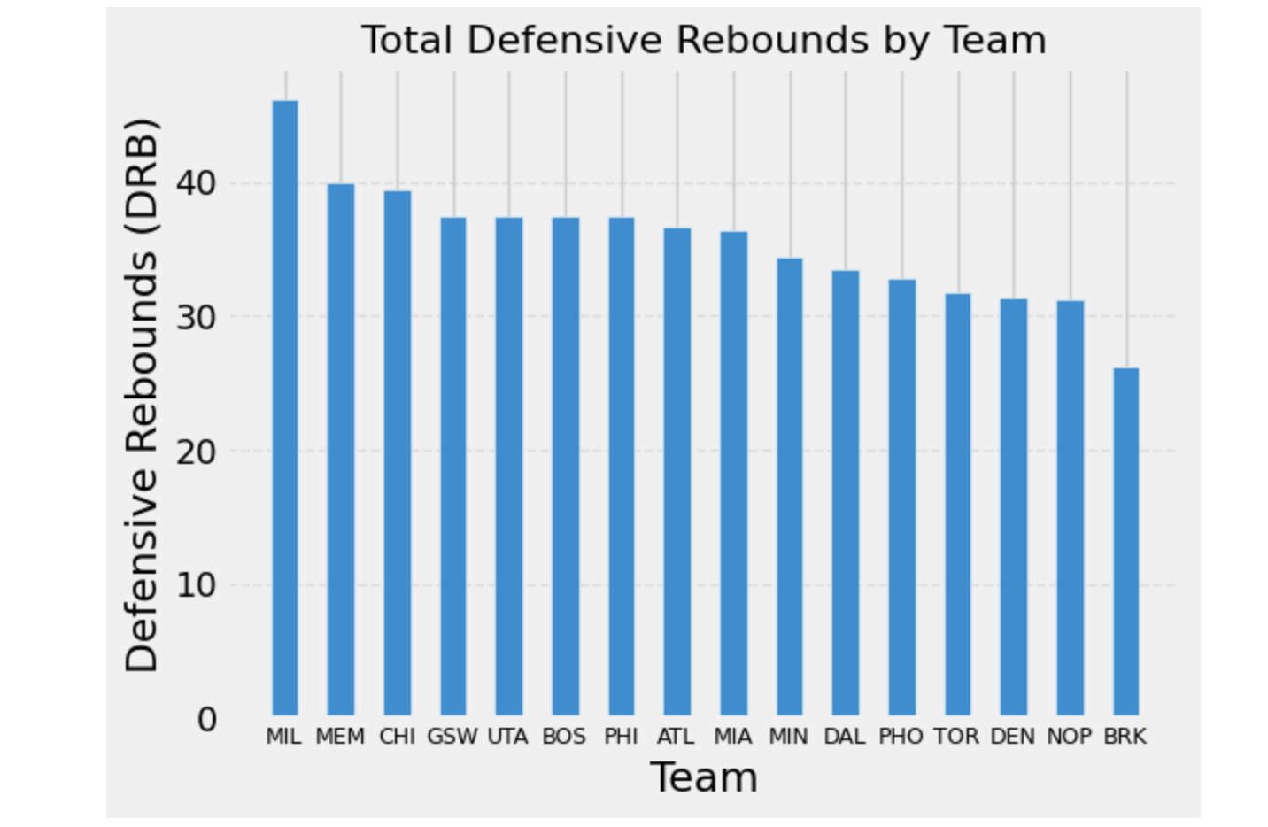
Mini Update 4- Data Insight Brittany
This graph shows the total defensive rebounds by every team in the 2021-2022 NBA playoffs. Because I saw that the offensive rebounds had some impact on the success of the team, I wanted to see if defensive rebounds had a similar pattern. What I found was that the top two finishing teams in the NBA playoffs were in the top 6 in defensive rebounds. The winning team was 4th, the runner up was 6th. The top teams in the playoffs were not the absolute best in defensive rebounds, but they still had good defensive rebounding numbers. Similar to the offensive rebounds, teams should still strive to be good at defensive rebounds, but it is not the end of the world if they are not. A team can still be successful if they are not particularly good at them, but if a team is good at defensive rebounding, it will definitely contribute to their success.
I wonder if there is one particular stat that heavily correlates with the success of a team? What is a stat that immediately makes a teams chances of losing fall dramatically?

Slide 5
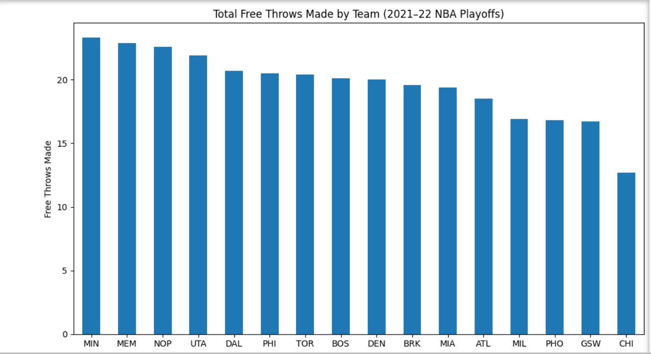
Mini Update 4: Data Insight Anna
I created this graph to compare the total free throws made by each NBA team during the 2021-2022 playoffs. The goal was to see which teams relied more on drawing fouls and scoring from the FT line. The results show clear differences in how often they reach the line. Interestingly GSW who won the championship that year, was second to last in FT made. This suggests their succes was not based on physical play or driving to the basket, but instead on their perimeter shooting. I will evalute this with my next graph.

Slide 6
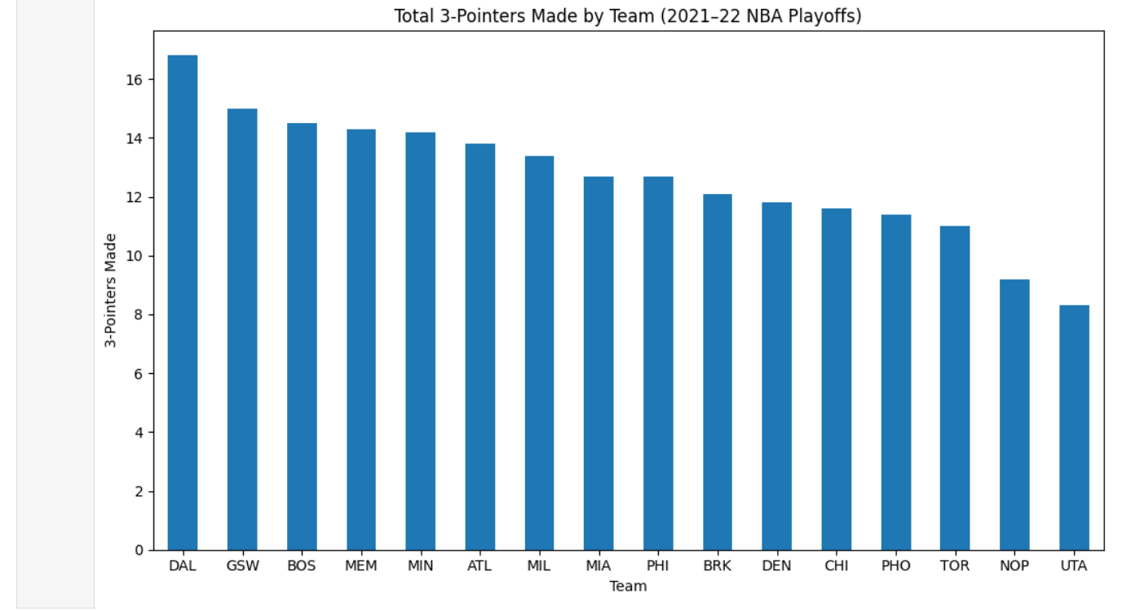
Mini Update 4: Data Insight Anna
I created this graph to compare the total number of three pointers made by each team during the 2021-2022 playoffs. The goal was to analyze how teams relied on perimeter shooting as part of their offensive strategy. The result showed that GSW had the second highest number of 3P made among all playoff teams. Thus supports my original idea that GSW’s success is heavily driven by their 3P shooting ability. Their offense is showing to be centered around the perimiter.

Slide 7
Mini Update 4- Data Feedback Brittany
The feedback we received was to make sure our insights were not too similar and to make sure we coordinate with each other what our insights will be on.
We were also told to each do another insight.
We addressed this by establishing that we are each going to do our insights on two different stats for every team in the playoffs.
This feedback was helpful because it allowed us to establish a plan for the rest of the weeks doing our data insights. Now we have an idea of how we will do this every week.
We like the type of feedback you are giving us so far, it is very helpful.

Slide 8
Mini Update 4- Data Progress Anna
What we accomplished
We conducted deeper statistical analysis for each NBA team that made the playoffs
Collected and organized key performance metrics across teams
Developed a hyptohesis on teh relationship between team statistics and rankings
Began identifying potential correlations between performance indicators and overal standings
Plan for next week
Continue to test and analysis our new hypothesis
Continue to create graphs to represent the data
Maybe look into GSW who won the playoffs, and the team that finished last place, and see if we notice any significant differences
Obstalces/help needed
Feedback and validity on our new hypothesis

Slide 9
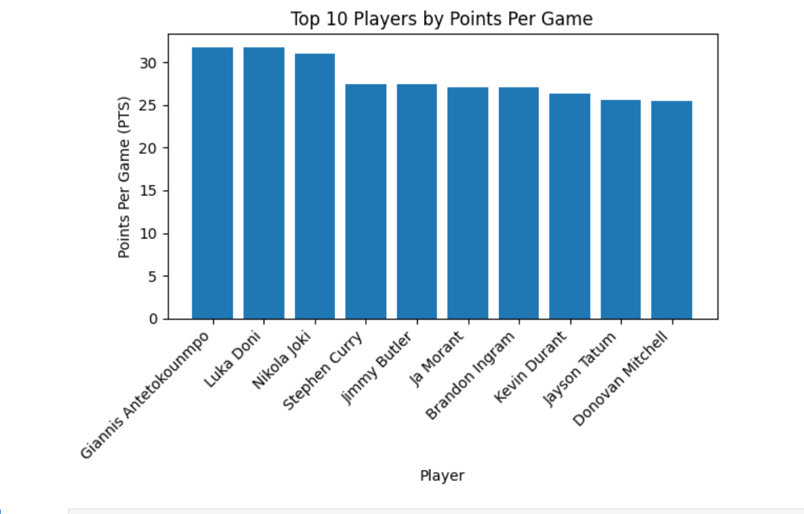
Mini Update 3- Data Insight: Anna
This histogram shows the distribution of players’ points per game (PPG)
The majority of players average relatively low scoring outputs, with most only just above 0 points per game. Only a small number of players reach high scoring averages, showing that elite scoring performances are uncommon
This pattern suggests that having many high scoring players on one team is rare
This raises an interesting question, how would this distribution if we only looked at the top 10 ranked players?

Slide 10
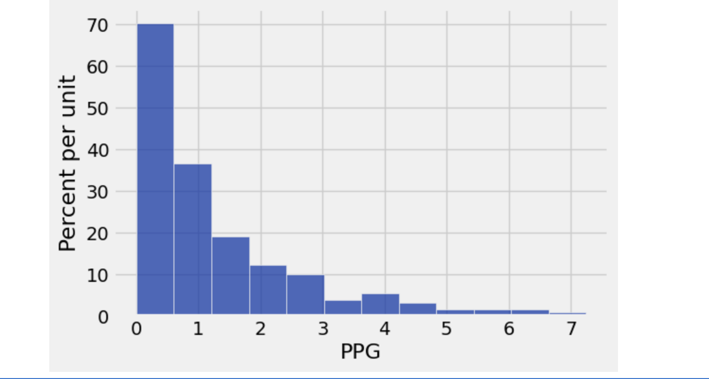
Mini Update 3: Data Insight-Brittany
This is a histogram showing the distribution of the players points per game.
Majority of the players averaged just above 0 points per game they played in
Only a few players averaged high scoring games
Having a lot of high Scoring players on a team is very rare
This histogram shows that in the NBA playoffs, players are not just good because they can score a lot of points. There are many factors that can determine how good a player is.
I wonder how different this histogram would look if I only used the stats from the top 10 ranked players?
Would their data tail more to the right? Would it be more evenly distributed?
If I only looked at the players of the best team in the NBA, would the data look similar to this graph?

Slide 11
Week 3-Data Feedback(Brittany)
The feedback we received was to ask more questions about our data after we analyzed it
We addressed this by asking more questions about the implications of our data
I think this feedback was useful because it allowed us to be able to think deeper about the data we found.
We only ask that with the additional feedback in the future that you let us know if there is a better way for us to show or demonstrate our data.

Slide 12
Week 3- Data Progress- Anna
Continue to delve deeper into analyzing the data, and what attributes make the top ranked players
Continue applying the feedback given to update and improve our graphs to better represent the data
Brittany and I split the work evenly and work well together

Slide 13
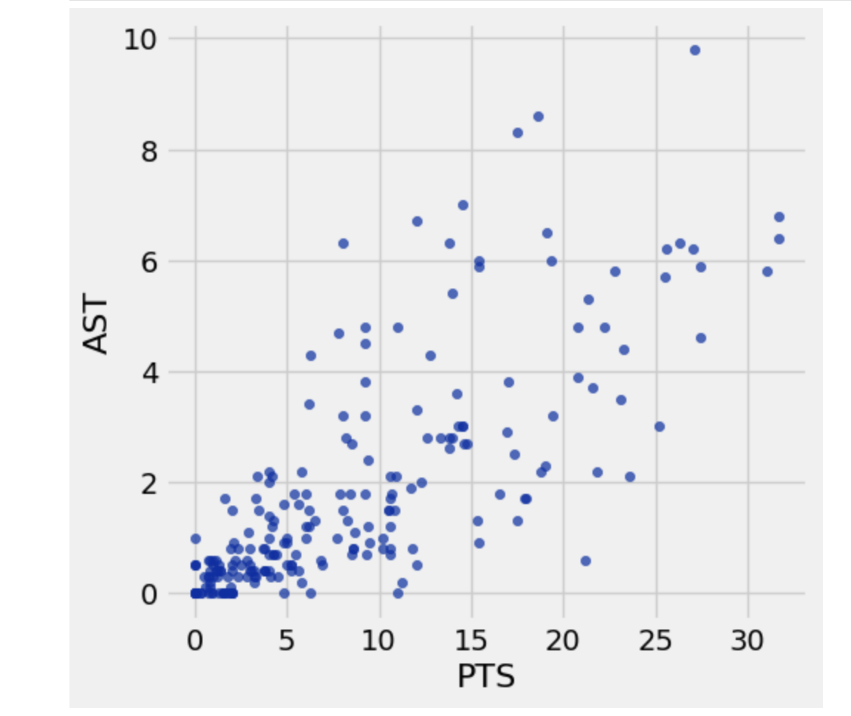
Mini Update 2: Data Insight: Points and Assists(Brittany)
This scatter plot is showing the relationship between the amount of points every postseason player scored and the amount of assists(passes to a scorer) they had.
I found this interesting because normally these two stats do not necessarily correlate in basketball, but if they do, that is better for the team
The data on this plot means that the higher scoring players tend to pass a lot to other players who also score
When this happens, it allows a team to score more points, which makes it easier to win
Winning is essential in the NBA playoffs
Since this plot looks like this with these players, will it be similar with PTS and Rebounds?

Slide 14
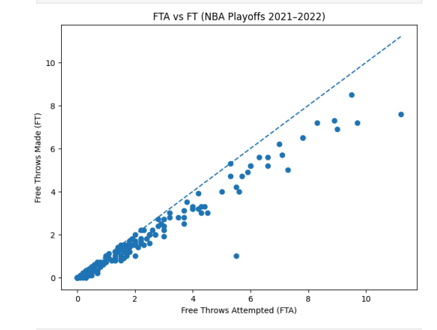
Data Insight: FTA vs FT (Anna)
This scatterplot represents the amount of Free Throws attempted vs. the amount of free throws that were made.
I found this interesting because these two statistics are directly related in basketball. The more FTA the more FT a player can make
The data on this plot shows that players with higher FTA generally also have higher FT, but the key difference is how close they are to converting these attempts consistently, especially in the playoffs
The dotted diagonal line represent 100% of FT made.
I am wondering now the percentage of free throws made vs the free throw taken.

Slide 15
Data Feedback(Brittany)
I think the feedback we took to heart was the one about aligning our communication goals with the audience
This feedback allowed us to realize we needed to go into more detail about our stats so that our stats could be interesting to the sports betters, trivia masters, and coaches who want to know all the little, tiny, interesting things about the NBA playoffs
The feedback is useful because it allows us to realize how deep we should be thinking about our data.
The additional feedback we are seeking is guidance of whether or not we are on the right track for our stats.

Slide 16
Data Progress
Accomplishments
Anna- data progress and FTA vs FT scatter plot
Brittany- data feedback and Points vs Assists scatter plot
Plan for next week
Continue to split responsibilities
Refine analysis and visualizations
Obstacles
No major obstacles but open to feedback and guidance
Resources used
Assisted Anna in creating a dashed line representing 100% FT made on a scatter plot

Slide 17
Mini Update #1-Data Profile
This dataset has 217 rows and 30 columns.
Google Sheets of Data Profiling Table https://docs.google.com/spreadsheets/d/1TsghxFWiK-NHE4CaMbX1p-QQBlQih_dUIpUvzrBDwkE/edit?usp=sharing

Slide 18
Mini Update#1-Curious Question(Anna)
Do star players (high scorers) also contribute across other stats like assists and rebounds?
Which teams had the most well rounded player performances?
Is there a relationship between games played and player performance?
Audience:
Sports fans interested in NBA playoff performance
Coaches or analysts looking for player insights
Fantasy basketball players

Slide 19
Curious Questions- Slide 2(Anna)
Communication Goal:
Improve understanding of player performance beyond just points scored
Change perspective by showing well rounded players
Encourage deeper analysis of sports statistics rather than surface level metrics

Slide 20
Mini Update #1-Audience/Communication Goal(Brittany)
Our audience is going to be basketball fans, analysts, and broadcasters who are looking for insights on players and their stats.
Our goal is to be able to give the audiences details of standout games, team trends, and upcoming predictions based on the 2021-2022 NBA playoffs.
Another goal we have is to be able to give the audience niche stats that they would have never have thought of. Stats that are very relevant, but out of the ordinary.
Stats essential for sports betters, trivia knowledge, and basketball coaches/players

